Slide 1


an Overview of Ubuntu
By Simon, Saul, Sam, Jade, eoin.

Slide 2

Introduction
History
CPU Scheduling
File System
I/O Hardware
Memory Management
Security
Conclusion

Slide 3

Overview
Ubuntu is a Linux based operating system
Created for computers and smartphones
Open source
Supports software for Windows
ie. Chrome, Firefox, VLC etc

Slide 4
History
First Release in 2004
Based on Debian architecture
Was created to be more human friendly
Was named to mean “humanity to others”
Notes:
Debian is another linux based operating system

Slide 5
Canonical
The current developer and funder of ubuntu
UK based software company
Founded by Mark Shuttleworth in 2004
Ubuntu is main project backed

Slide 6
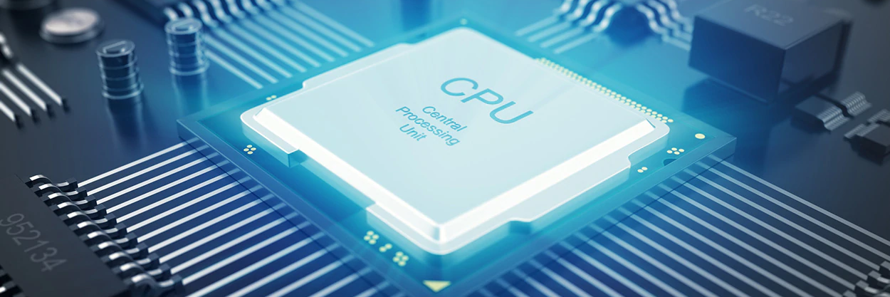
Cpu Scheduling on a Ubuntu machine

Slide 7

SO what’s a CPU?
A CPU, or Central Processing Unit. Is the “Brain” of your personal computer. It executes the instructions that make up a computer program. - David Kuck, Computers and Computations vol 1

Slide 8
So why do we need scheduling?
Make a CPU More Efficient
Fairly Allocate CPU Resources
Increase the Max Throughput of the CPU
Reduce the Waiting Time Between Instructions

Slide 9

The different methods of scheduling
First Come first Serve: Allocates an instruction based on what time it comes in
Shortest Job First: Instructions are completed based on how small they are
Round Robin: Each instruction is allocated the same amount of time
Longest Job First: Instructions are completed based on how big they are

Slide 10
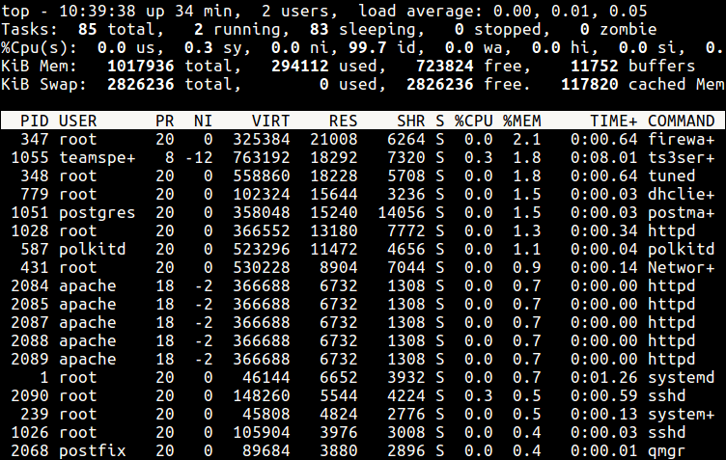
So what does this look like?

Slide 12

FILE SYSTEM OF UBUNTU

Slide 13
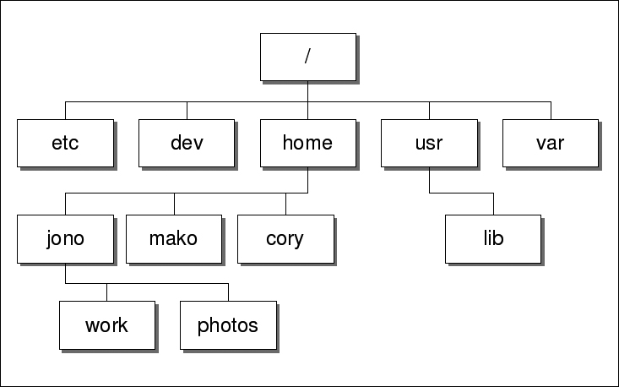
Files in Ubuntu
In Ubuntu everything is a file
Including Hardware and directories

Slide 14

File paths
Absolute paths: Show the complete path of file
Example: /usr/bin/test
Relative paths:Show paths relative to current directory
Example: bin/test

Slide 15
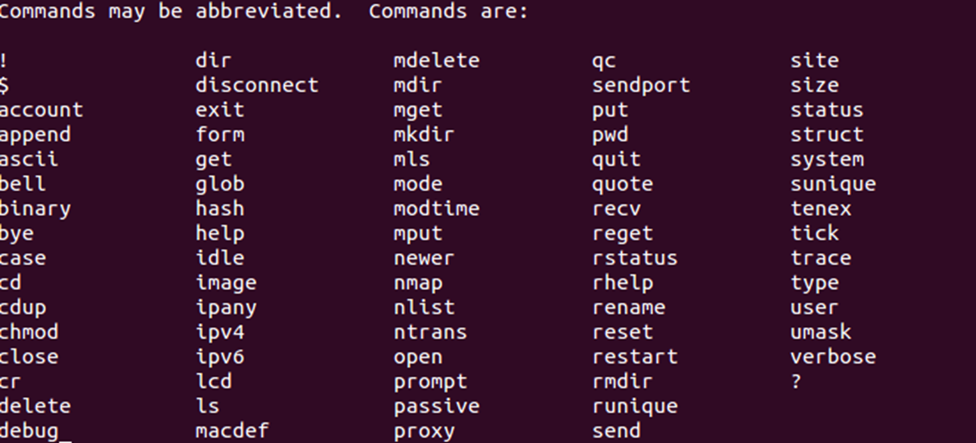

Slide 16
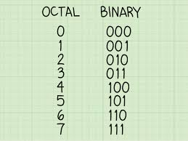
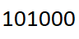
Octals
Primarily used for indexing
Separated into groups of 3 and read in binary

Slide 17
Block allocation
Block allocation maps
Used to track disc blocks in use
Found in directories
Each directory tends to contain 8 or 16 blocks
Allows a single directory to have multiple entries

Slide 18

Hardware Management in Ubuntu

Slide 19
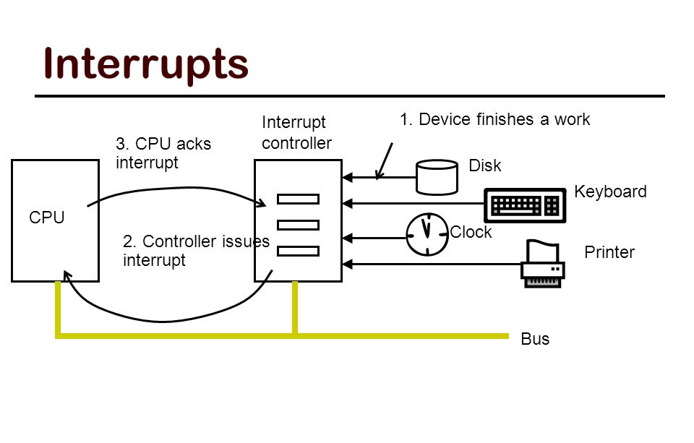
Hardware and Interrupts
Device processes slower than CPU
Interrupts allow seamless access
Standard across Linux distros

Slide 20
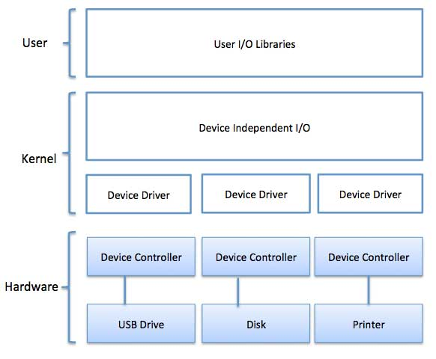
Input / output devices
Recognised through files in system
Three ‘driver’ types:
Block
Character
Network

Slide 21
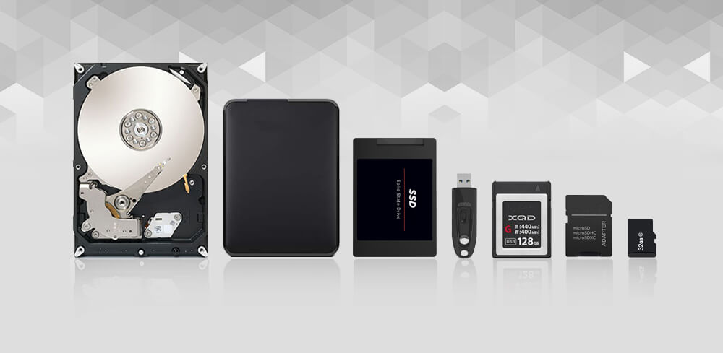
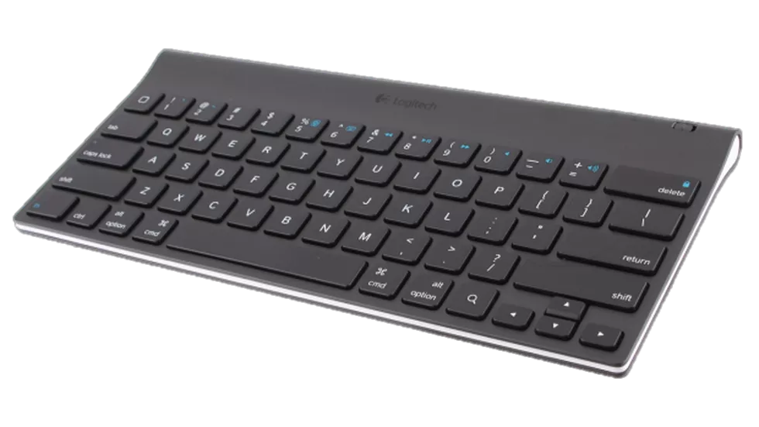
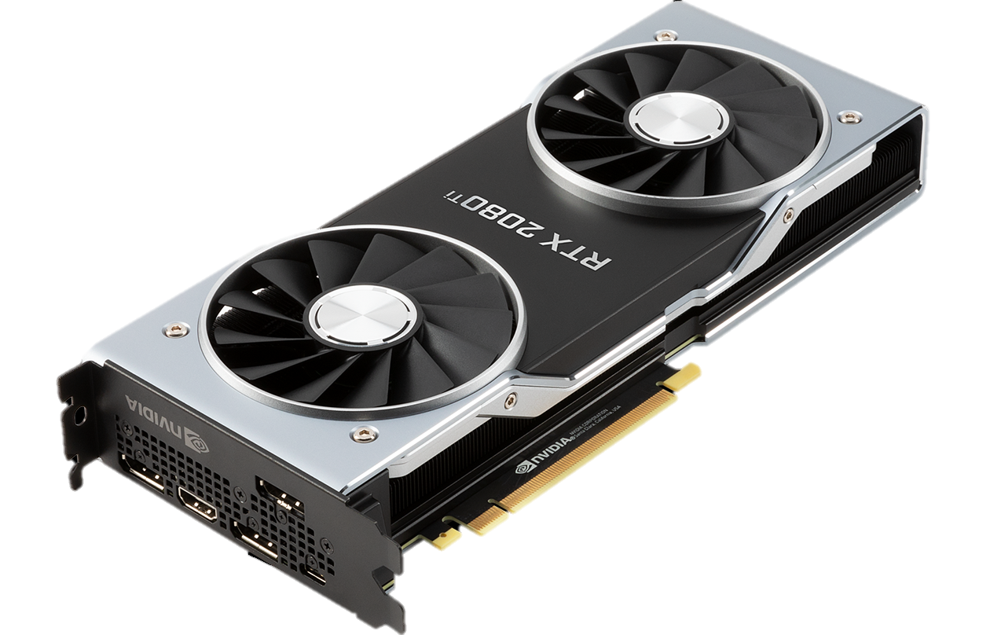
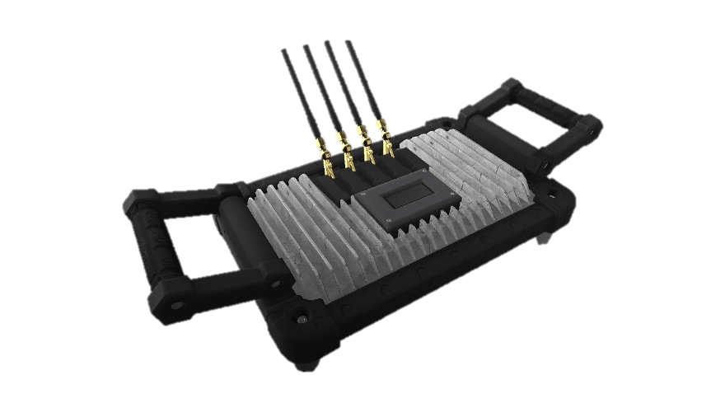
I/O types:
Block: Anything that accesses memory
Character: Outputs audio-visuals or inputs data
Network: Router, bridge etc

Slide 22
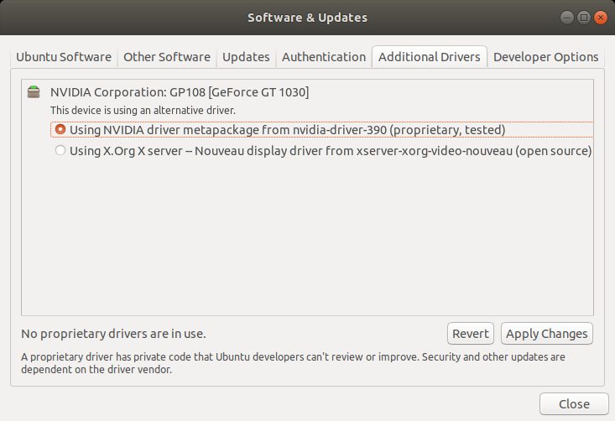
Driver Management:
Managed through GUI or Command Line
Standard devices supported by default:
Peripheral devices require further installation
Helpful for proprietary uses of Linux

Slide 23
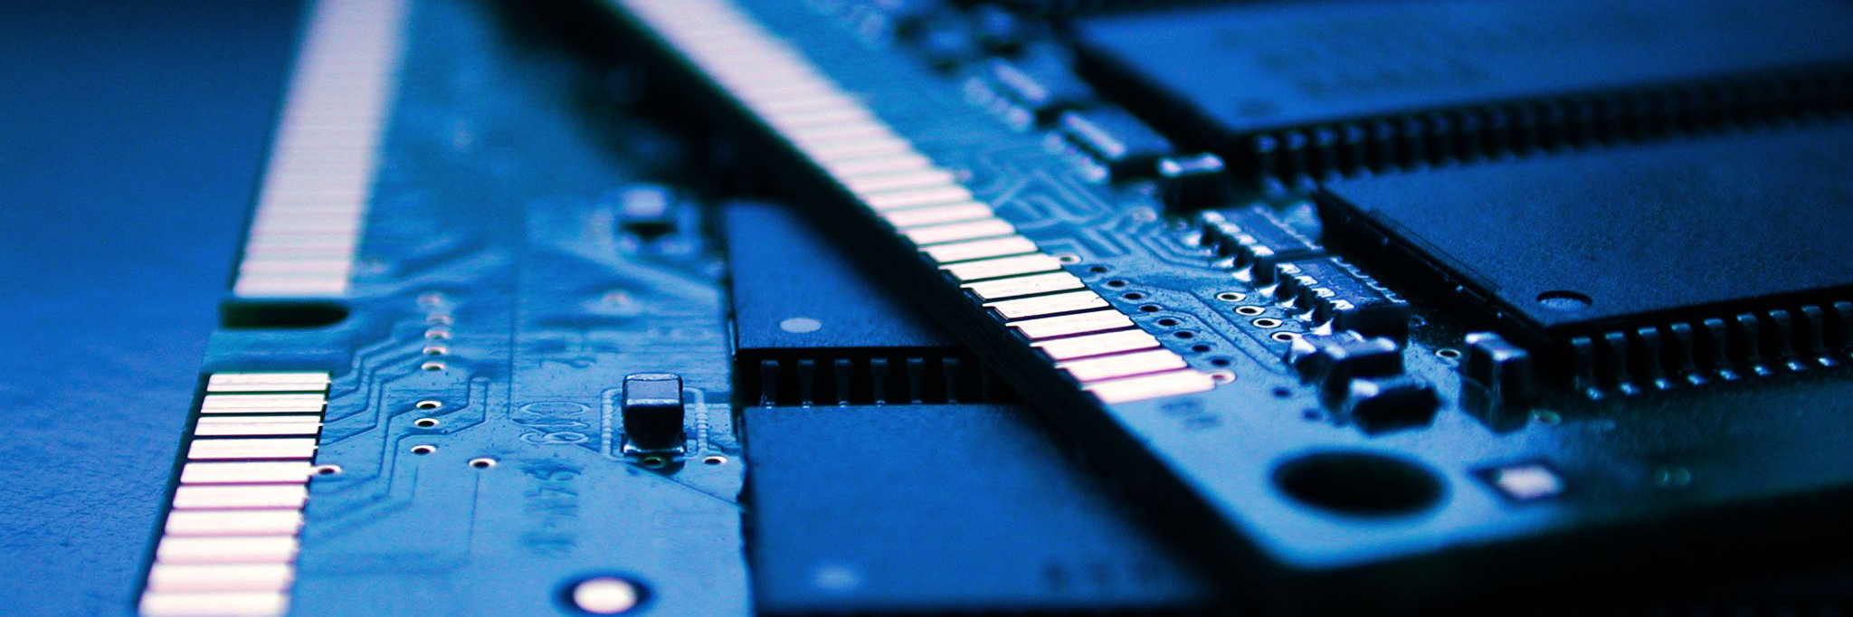
Memory Management on a Ubuntu Machine

Slide 24

SO what’s memory?
Computer memory is any physical device capable of storing information temporarily. - David Kuck, Computers and Computations vol 1

Slide 25
So why do we need memory management?
Prevent system holdups and system crashes
Fairly allocate memory to programs that need it
Increase parallelisation between programs
Clean up junk other programs leave behind

Slide 26
So how does it work?
When a program requests a block of memory, a part of the memory manager called the allocator assigns that block to the program.
When a program no longer needs the memory those block are reclaimed by the OS
This is either done automatically by the OS, or manually by the programmer.

Slide 27
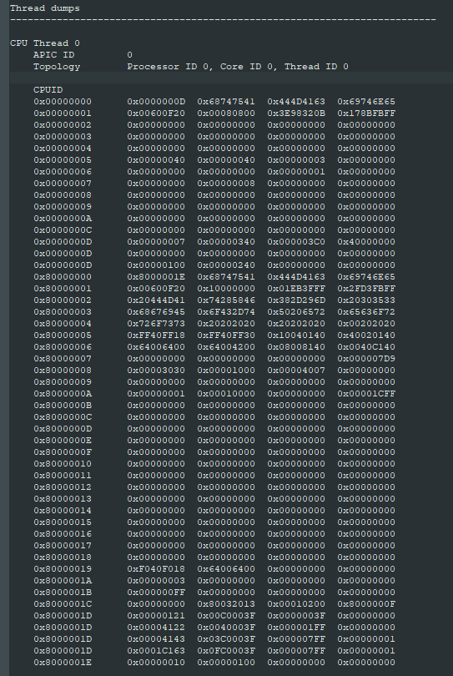
So what does a UBUNTU computers memory look like?
Here’s a memory dump I executed on a Ubuntu machine.
A memory dump is the contents of your computers memory saved to a file.

Slide 28

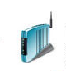
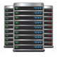

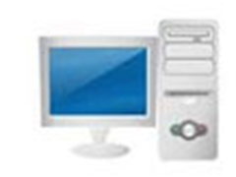

NETWORKING AND SECURITY
How does Ubuntu get online?

Slide 29
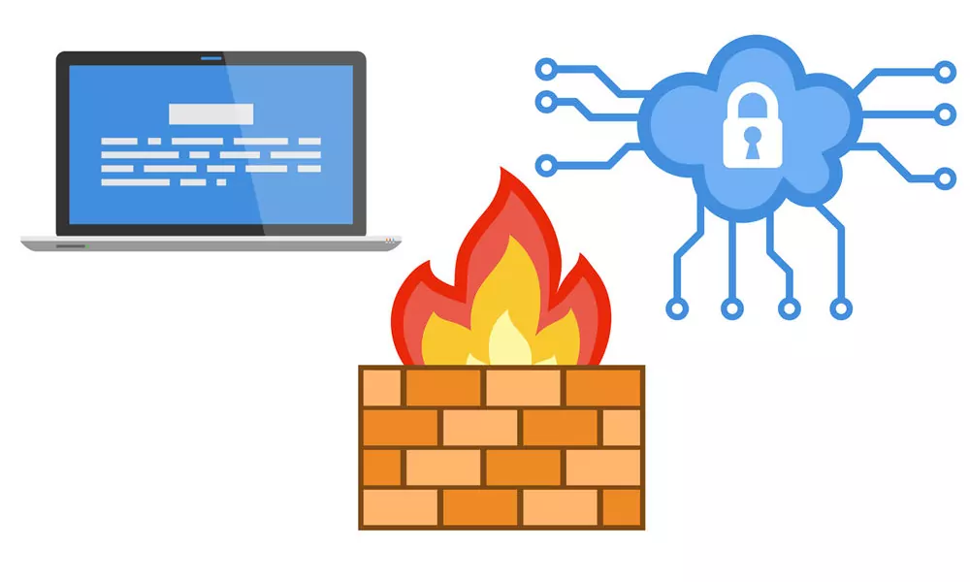
Network security - FIREWALL
Hide real IP
Port filtering
Packet filtering

Slide 30

File security

Slide 31
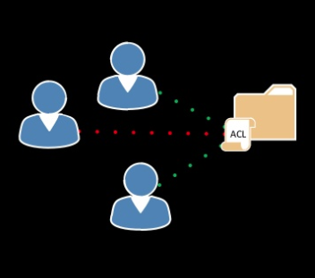
access control lists
Discretionary access control (DAC)
Decide what users can do

Slide 32


APP ARMOR
Mandatory access control (MAC)
Specifies what a program can do

Slide 33
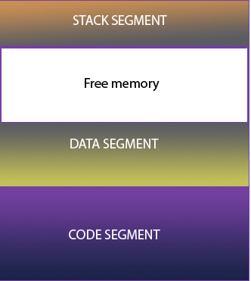
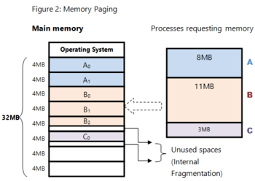
MEMORY and process PROTECTION
Segmentation
Paging

Slide 34
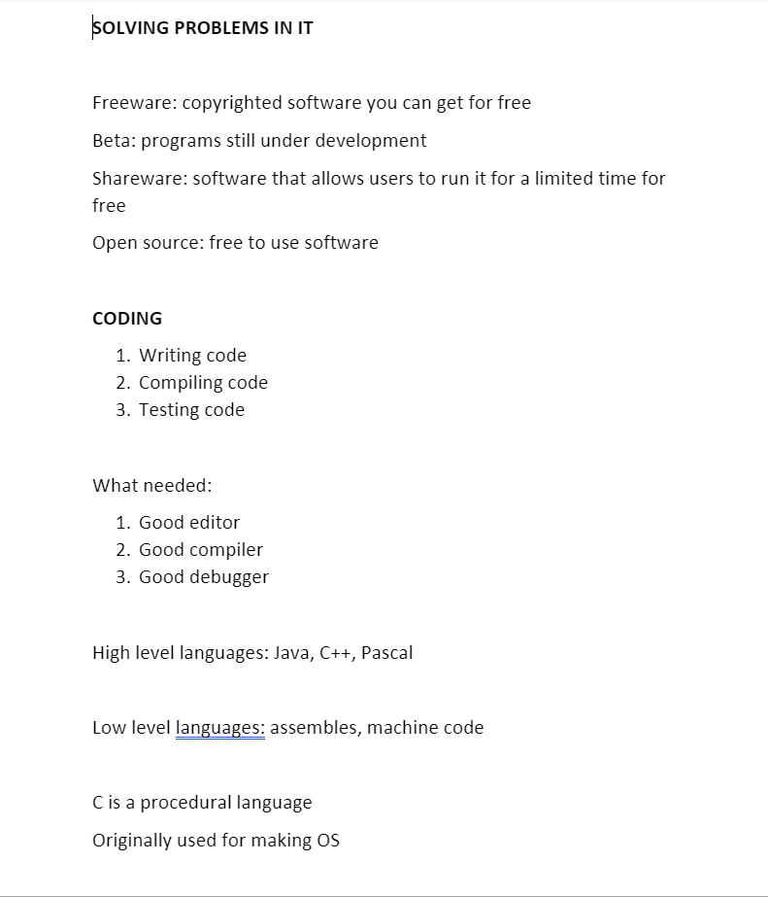
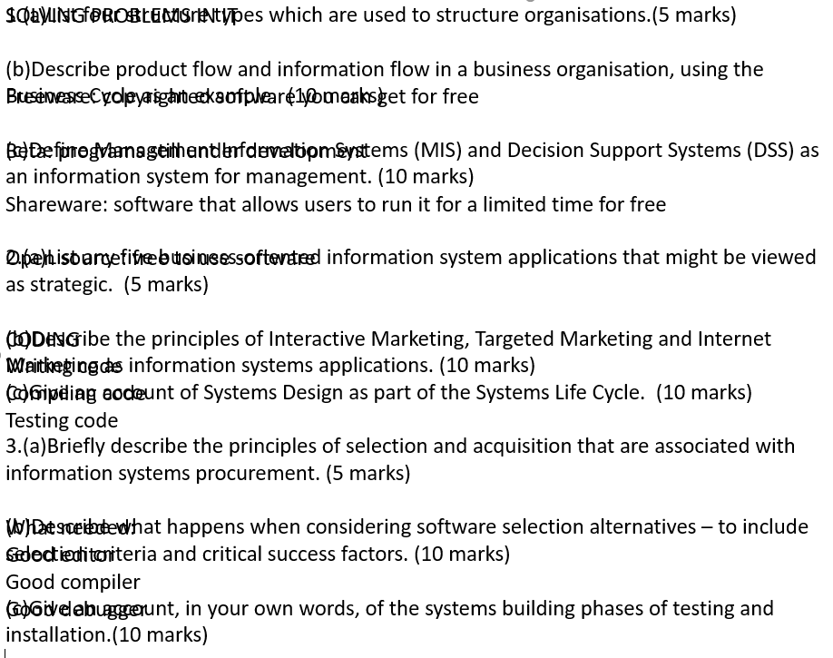
Why is it necessary?

Slide 35
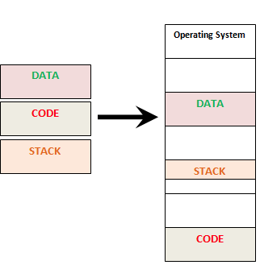
Segmentation
Break up program
Load into ram non-contiguously

Slide 36
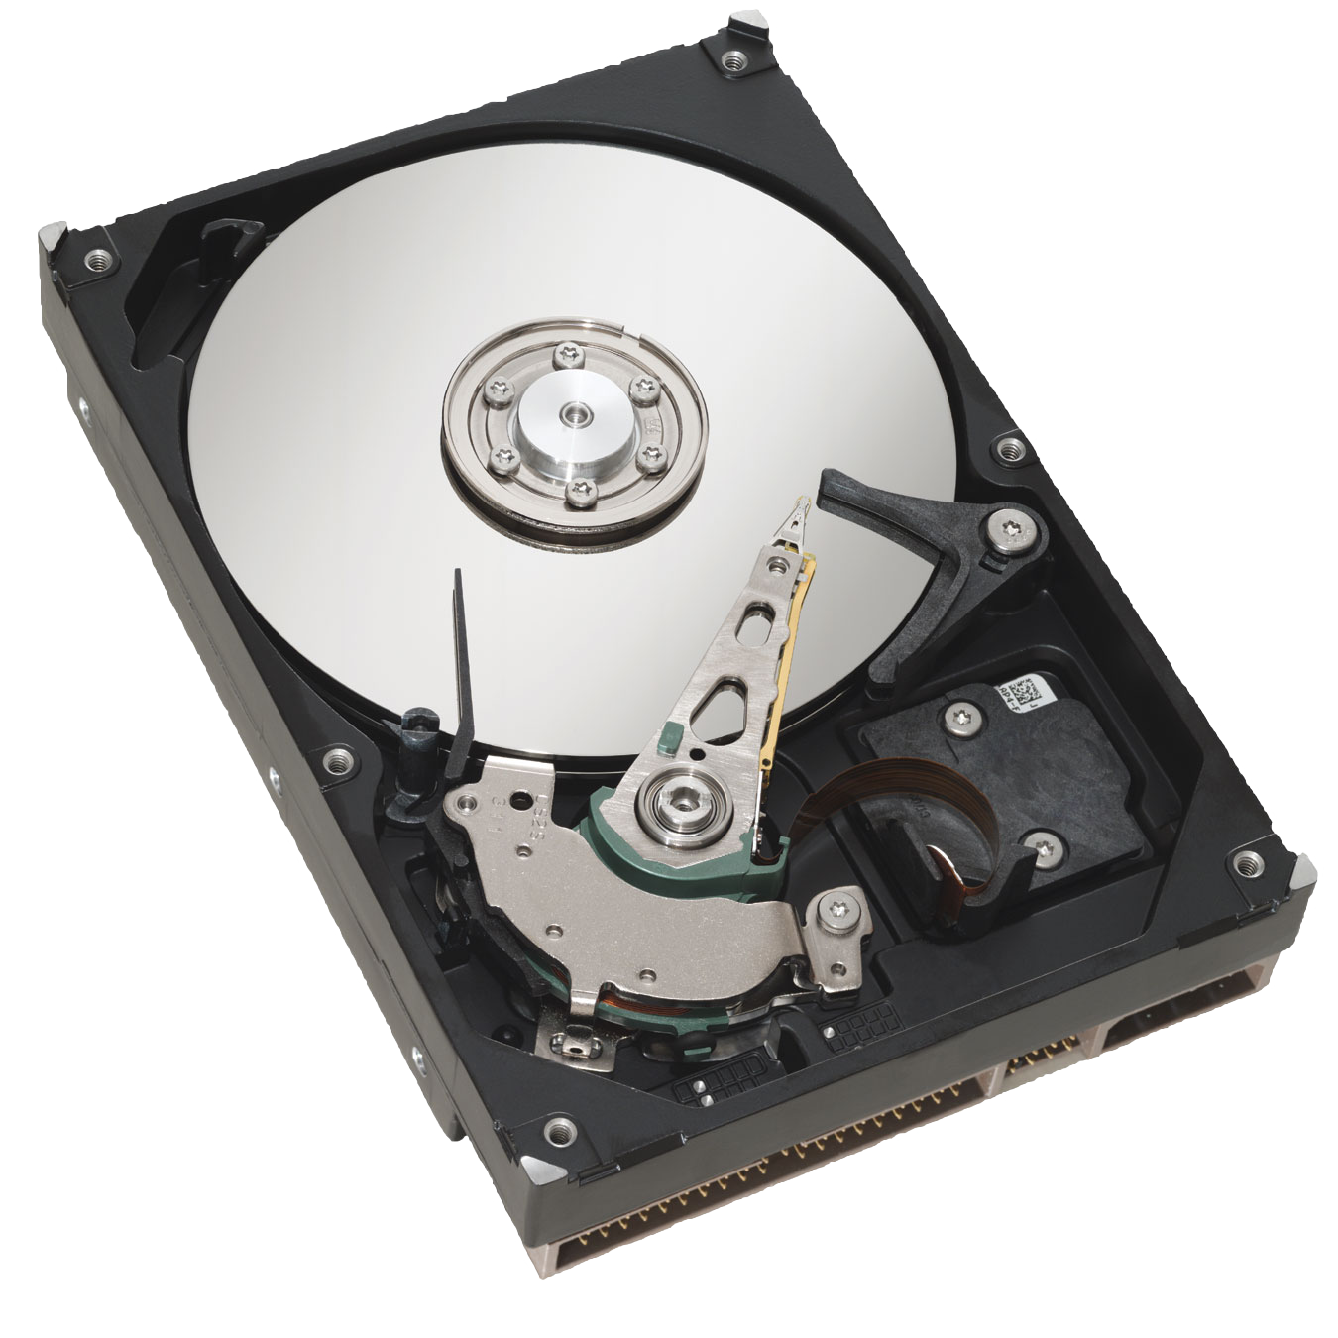
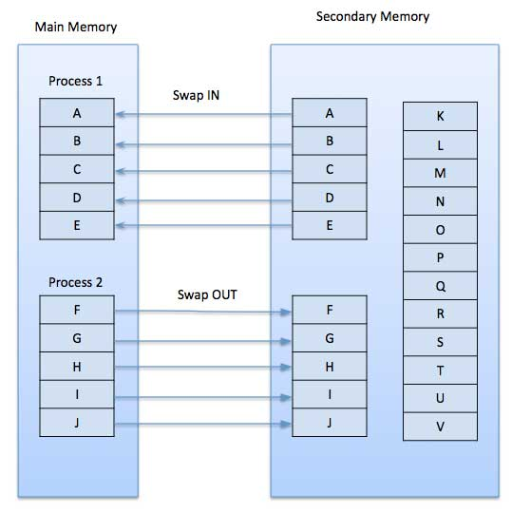
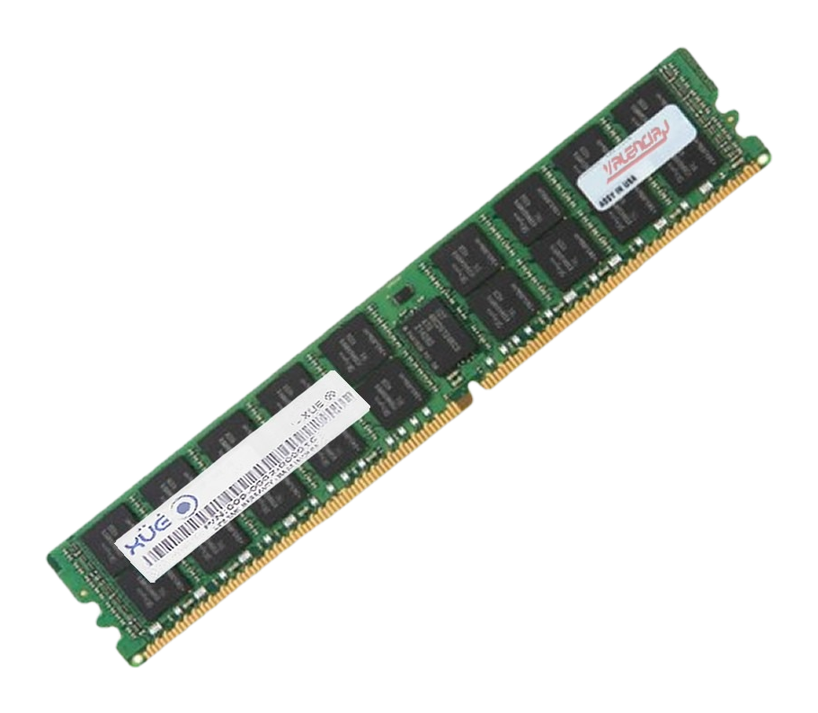
Paging

Slide 37
Sources
https://wiki.ubuntu.com/BasicSecurity
https://manpages.ubuntu.com/manpages/bionic/man7/pkeys.7.html
https://www.linux.com/tutorials/overview-linux-kernel-security-features/
https://www.slideshare.net/akbarazwir/abac-and-the-evolution-of-access-control
https://study.com/academy/lesson/memory-segmentation-definition-purpose.html
https://searchservervirtualization.techtarget.com/definition/memory-paging
https://www.computerhope.com/issues/ch001358.htm
https://wiki.ubuntu.com/AppArmor

Slide 38
Thank you!

